Slide 1
Medicare Inpatient Hospitals
Hospital Charges: What We Found
What drives hospital billing, and how it compares to what Medicare actually pays.
By : Nandita Sharma
Github: https://github.com/nandita96
Source: CMS Medicare Inpatient Hospitals by Provider & Service • 146,427 hospital-diagnosis records • 2,945 hospitals

Slide 2
WHAT WE'LL COVER
Six Questions We Set Out to Answer
1
Does the price for the same diagnosis vary a lot between hospitals?
2
Does the same surgery cost different amounts in different states?
3
Do bigger hospitals charge less, the way bulk buying usually works?
4
If a hospital bills more, does it actually get paid more?
5
Which procedures show the biggest gap between billed and paid?
6
Bonus: what actually decides the price, more than anything else?
Executive Summary: Key findings are summarised at the end of the presentation
Medicare Hospital Charge Analysis | 2

Slide 3
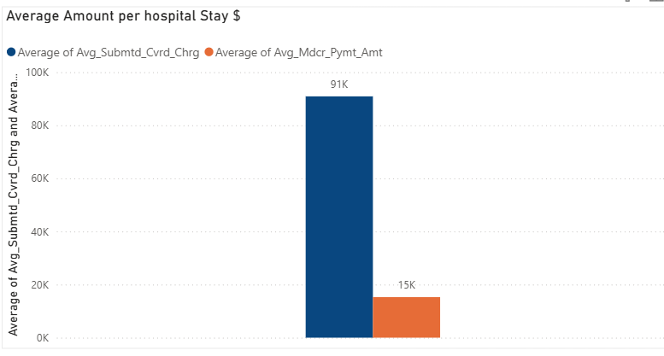
The Big Gap
Across every hospital stay in the dataset, here's the typical story.
5.5x
MEDIAN MARKUP
Hospitals bill about five and a
half times what Medicare pays.
The gap eats up roughly 79%
of the original bill.
Submitted Charge
Medicare Payment

Slide 4
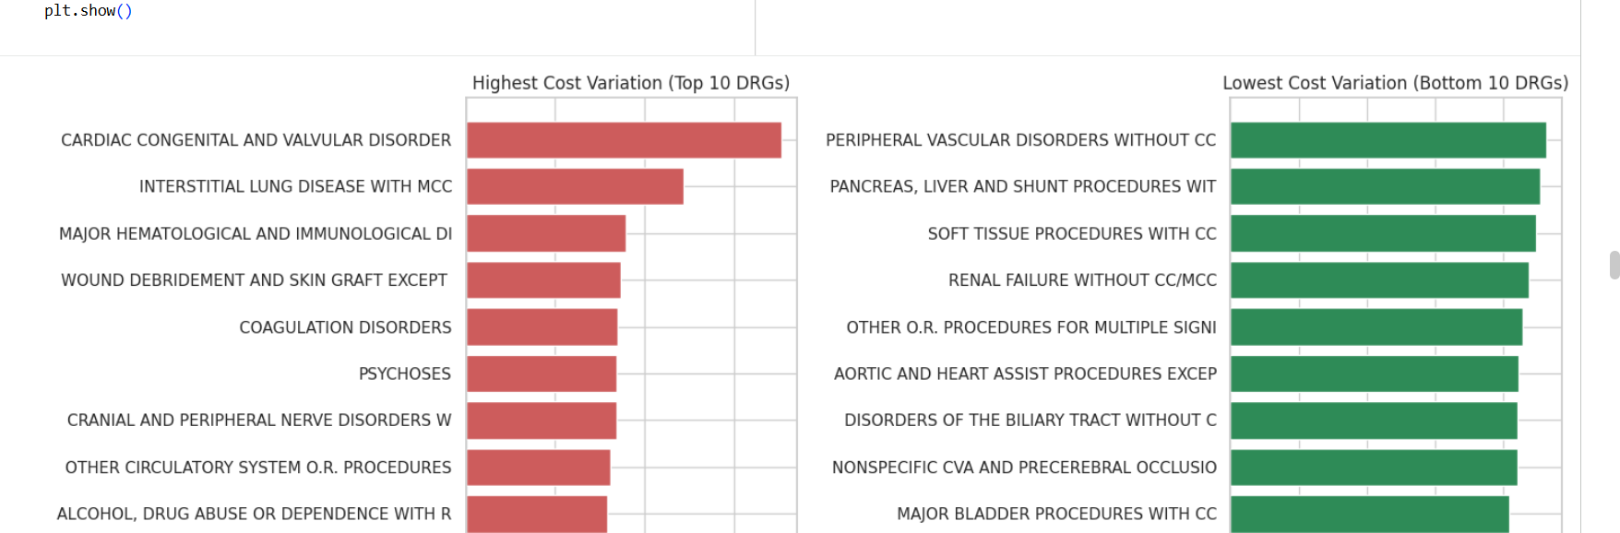
1
FINDING 1
Which services'(DRG) show the highest cost variation between providers?
Chart shows a relative price-inconsistency score (higher = hospitals disagree more on price for that diagnosis).
Medicare Hospital Charge Analysis | 3

Slide 5
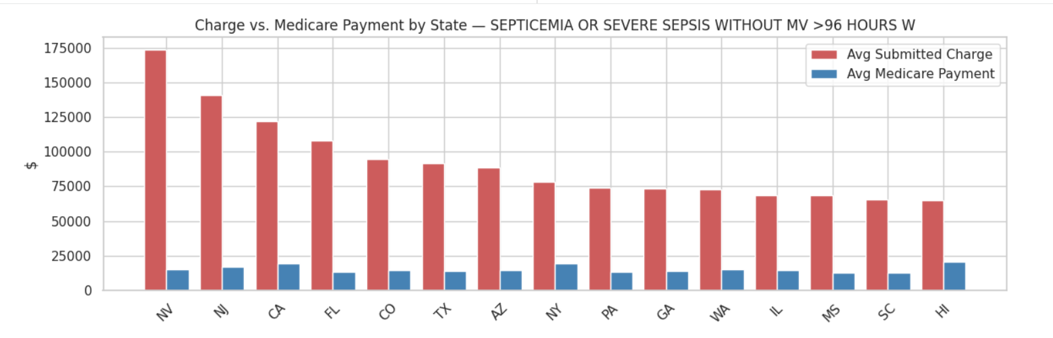
FINDING 2
2
Same DRG, Different Region, Different Price
I picked one very common, serious diagnosis — severe sepsis (a life-threatening infection) without >96 hours W — and compared the average charge state by state.
6.2x
difference between the highest- and lowest-charging state — for the exact same diagnosis.
Nevada: $173,926
Maryland: $27,908
Medicare Hospital Charge Analysis | 4

Slide 6
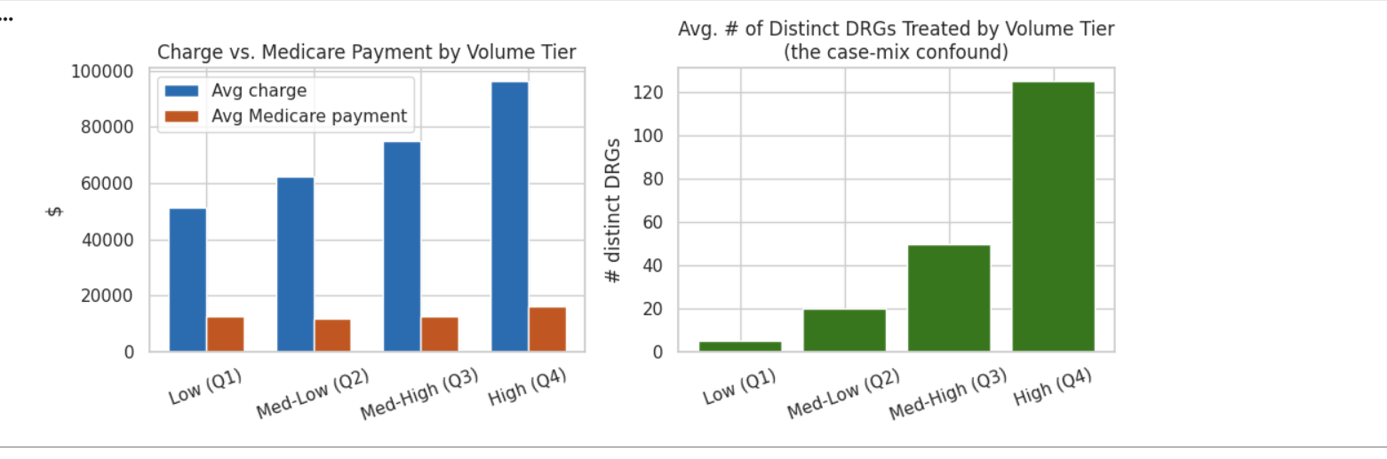
3
4
FINDING 3
"Buying in Bulk" Doesn’t Apply to Hospitals
You'd expect a hospital that treats way more patients to charge less per patient, like buying in bulk. The data shows the opposite.
125
distinct diagnoses treated by the busiest hospitals, on average — vs. just 5 for the quietest ones.
Busy hospitals bill more, not less. Partly that's because they handle a much wider, more complex case mix — big academic centers, not just "more of the same."
Medicare Hospital Charge Analysis | 5

Slide 7
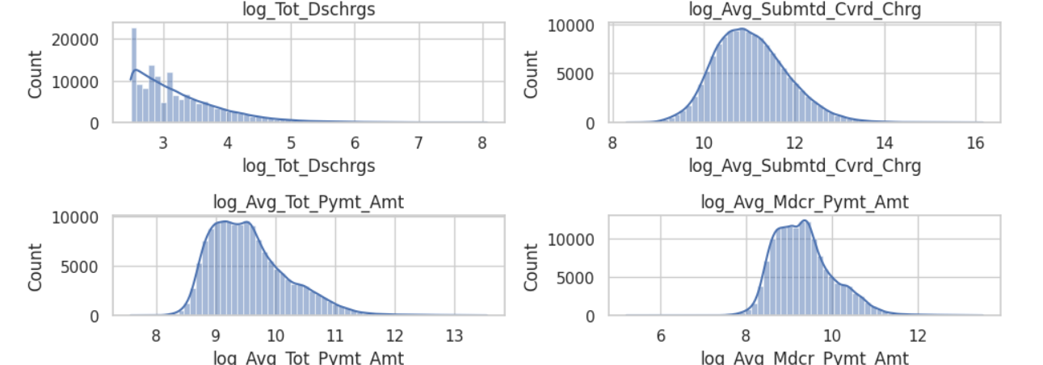
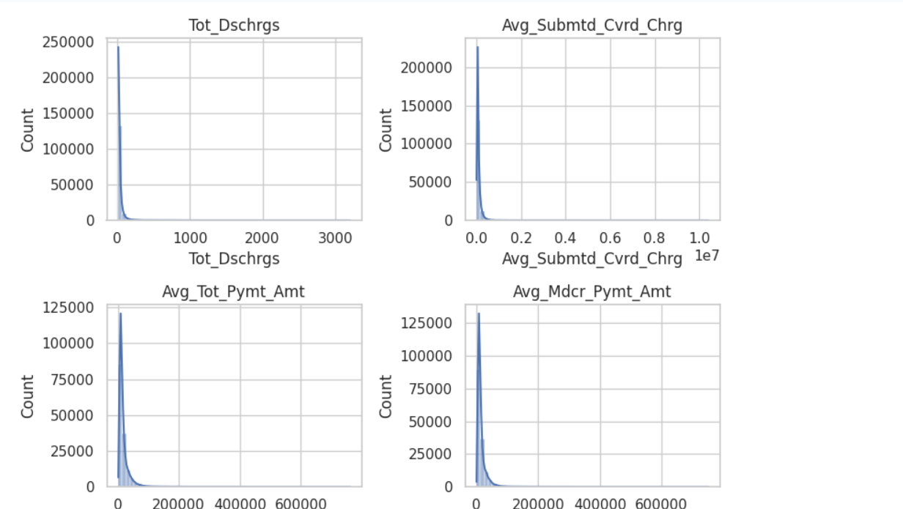
Outlier Understanding
Compressed box near zero, classic right-skew
Applying log1p to each column pulls the distributions much closer to a bell shape, which is why the log-transformed versions (log_Avg_Submtd_Cvrd_Chrg, etc.) are used later as model inputs instead of the raw dollar values.

Slide 8
5
Not All Gaps Are Created Equal
The DRGs with the biggest markup aren't the ones that cost Medicare the most money.
HIGHEST MARKUP
BIGGEST NATIONAL SPEND
Breast Biopsy / Excision
16.5x
$8.46B
Lymphoma, no complication
14.8x
paid out for Septicemia / Severe Sepsis with major complications — alone.
Kidney Transplant
13.4x
That's 2.7x more than the next-highest DRG. Not the biggest markup — just the most common, expensive diagnosis in America.
These are billed many times over what Medicare allows — but they're relatively uncommon procedures.
3

Slide 9
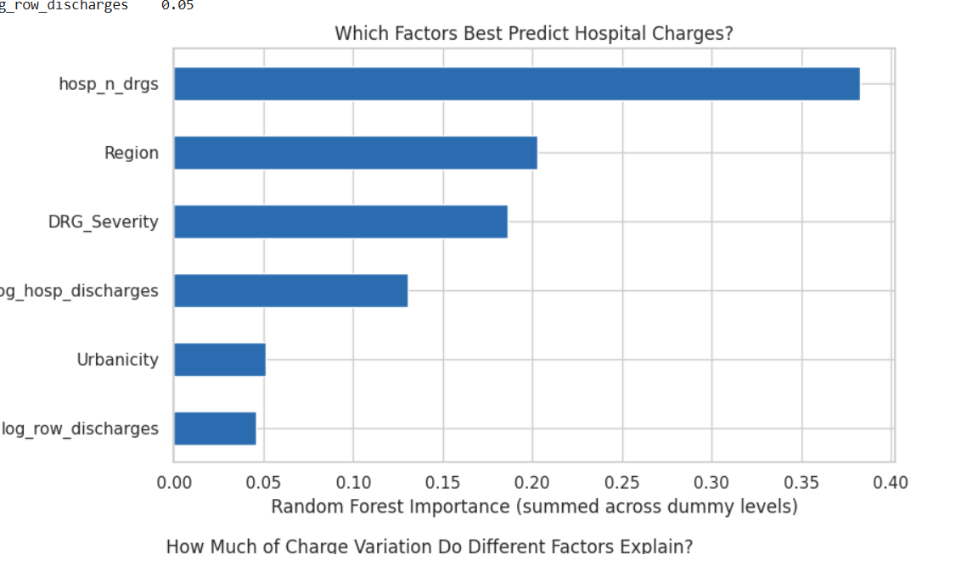
BONUS
So What Factors Decide the Cost?
58%
of the price difference is explained by just one thing:
What kind of case it is
(the diagnosis / procedure itself)
Everything else — hospital type, region, severity, size — explains a further ~25%. The rest comes down to individual hospital pricing choices we can't fully predict.
Medicare Hospital Charge Analysis | 9

Slide 10
Executive Summary
Area | Key finding
Data quality | 146,142 clean provider–DRG records after removing suppressed/missing rows and a handful of illogical rows (payment > charge). No duplicates.
Headline gap | Hospitals bill a median 5.5x (mean 6.35x) what Medicare actually pays
Outlier providers | 201 hospitals have ≥15% of their DRGs flagged as peer-group cost outliers
Cost variation by DRG | Some DRGs (e.g., cardiac congenital/valvular disorders, interstitial lung disease) show CV > 1.0 — providers disagree wildly on price for the same diagnosis; others are highly consistent (CV ≈ 0.4).
Regional variation (fixed DRG) | For the single most common DRG, the highest-billing state charges 6.2x more than the lowest, while Medicare's payment barely moves (<2x range) — Maryland's uniquely low markup (~1.2x) reflects its state-regulated all-payer rate system.
Volume / economies of scale | Higher-volume hospitals bill more, not less, per case — no evidence of economies of scale; largely confounded by case-mix breadth (high-volume hospitals treat far more distinct DRGs).
Charge–payment relationship | r = 0.81 between charge and Medicare payment — real but far from 1:1.
Predictors of cost | DRG identity alone explains 58% of billed-amount variance; once that's controlled for, hospital case-mix breadth and Region are the strongest remaining predictors of pricing behavior (Random Forest R²=0.25).
Highest-markup DRGs | Breast biopsy/excision procedures (16.5x), lymphoma without CC/MCC (14.8x), kidney transplant (13.4x) — not simply the most complex/expensive procedures.
Highest-spend DRGs | Septicemia/severe sepsis with MCC alone accounts for $8.46B in Medicare payments — 2.7x the next DRG — driven by volume, not markup.
Geography | Nevada, Florida, Colorado, New Jersey and Texas are consistently the highest-markup states across every method used (peer outliers, fixed-DRG comparison, state aggregation).
Rurality | A secondary factor — markup varies narrowly (5.6x–6.9x) by RUCA category, much less than the spread seen between states.
Provider concentration | The most extreme hospital-level markups cluster in a small number of New Jersey systems (Capital Health, Carepoint Health) and HCA-affiliated Florida hospitals — a system-level, not random, pattern.

Slide 11
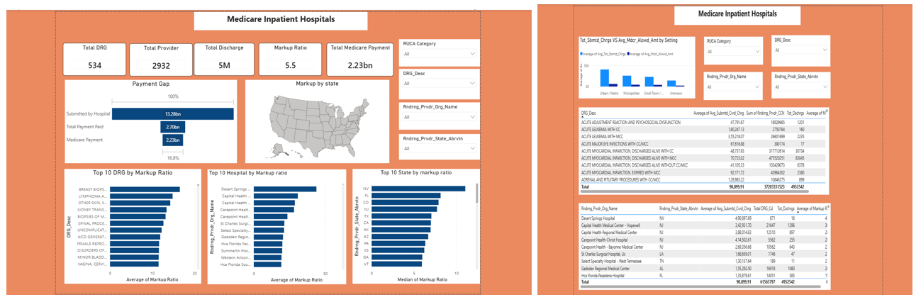
PowerBi report Snippet

Slide 12
Questions & Discussion
Full analysis, code, and charts available on Github https://github.com/nandita96.

